Slide 1
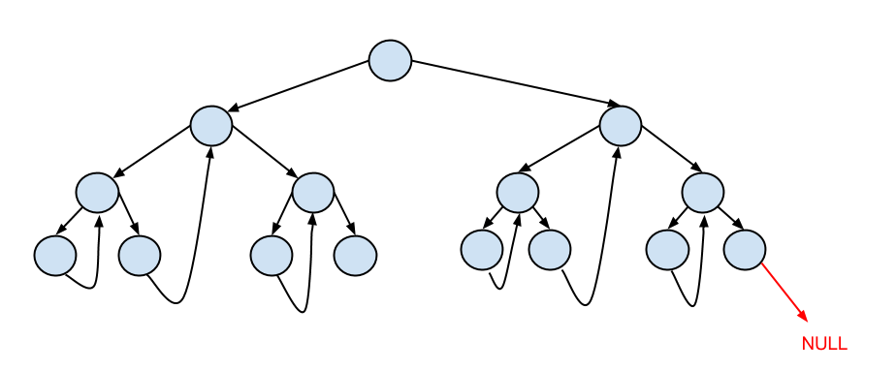
Consider this tree. We’re going to step through it in-order: start at the minimum node (leftmost) and stop at the maximum node (rightmost).

Slide 2
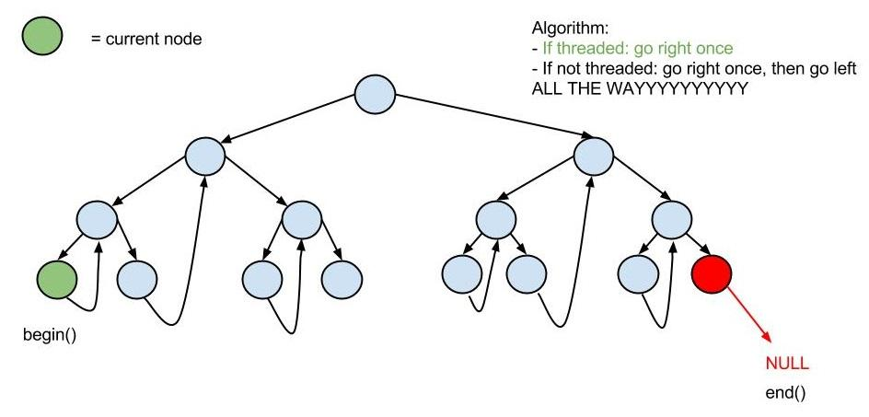

Slide 3
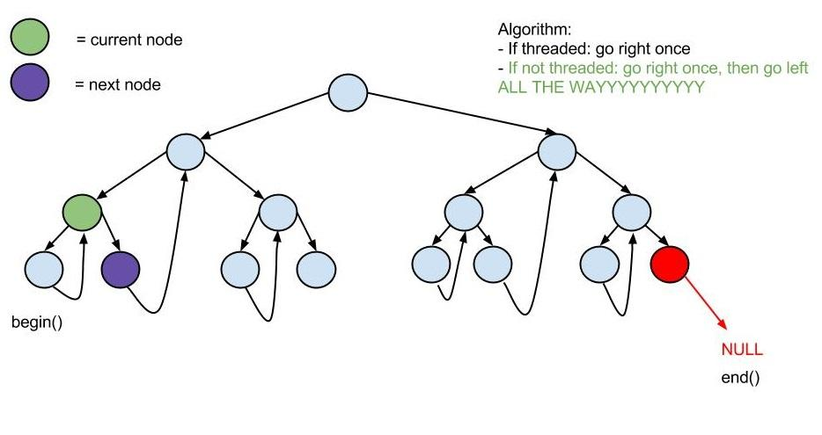

Slide 4
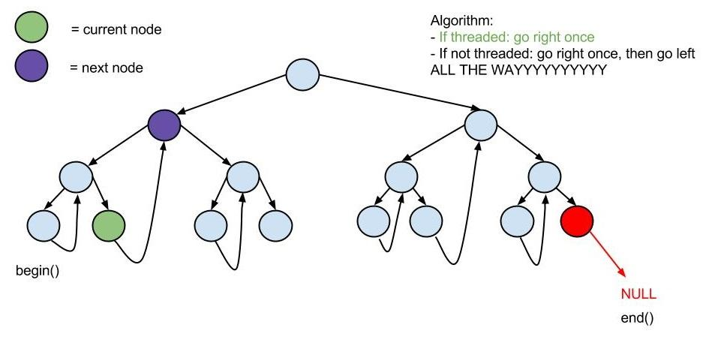

Slide 5
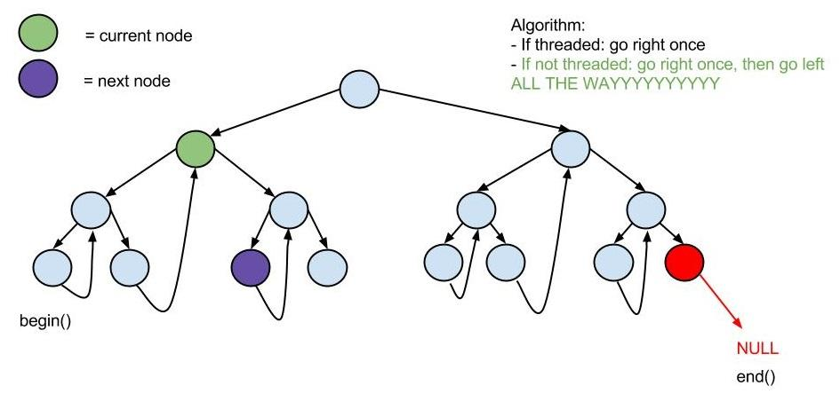
So on and so forth...
Notes:
So on and so forth...

Slide 6
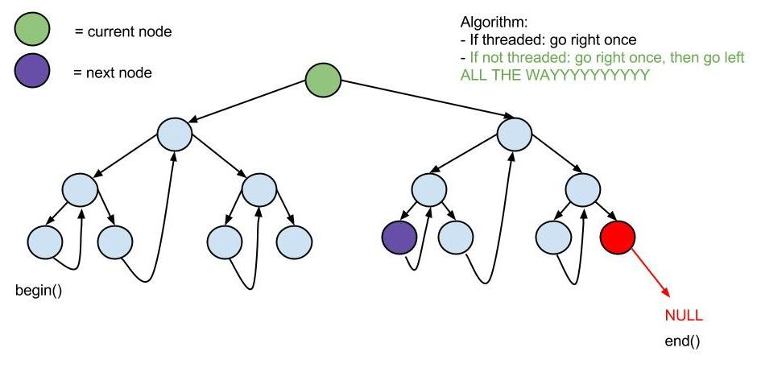
Notice the “going down left ALL THE WAYYYYY” part
Notes:
Notice the “going down left ALL THE WAYYYYY” part

Slide 7
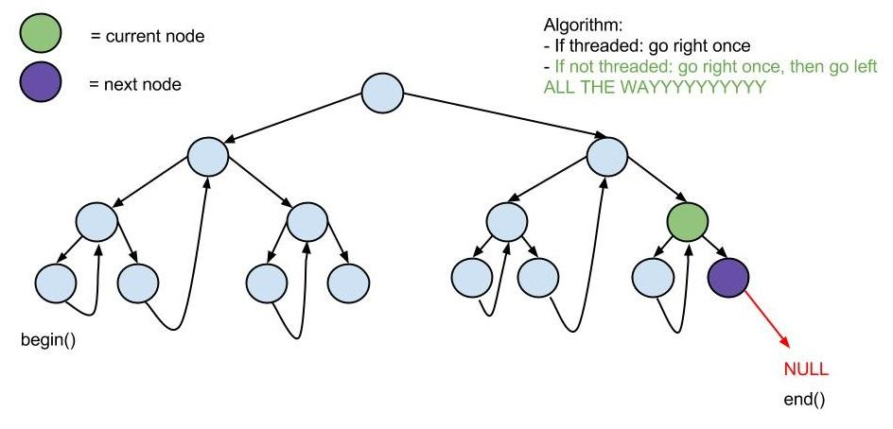
fast-forwarding to the end...

Slide 8
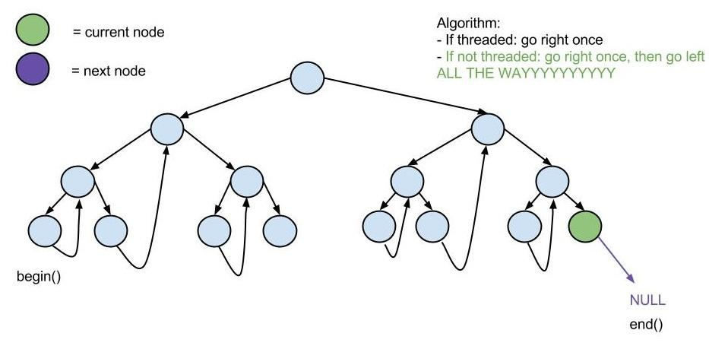
done.

